Slide 1
Machine Learning Basics
Machine Learning with Python

Slide 2
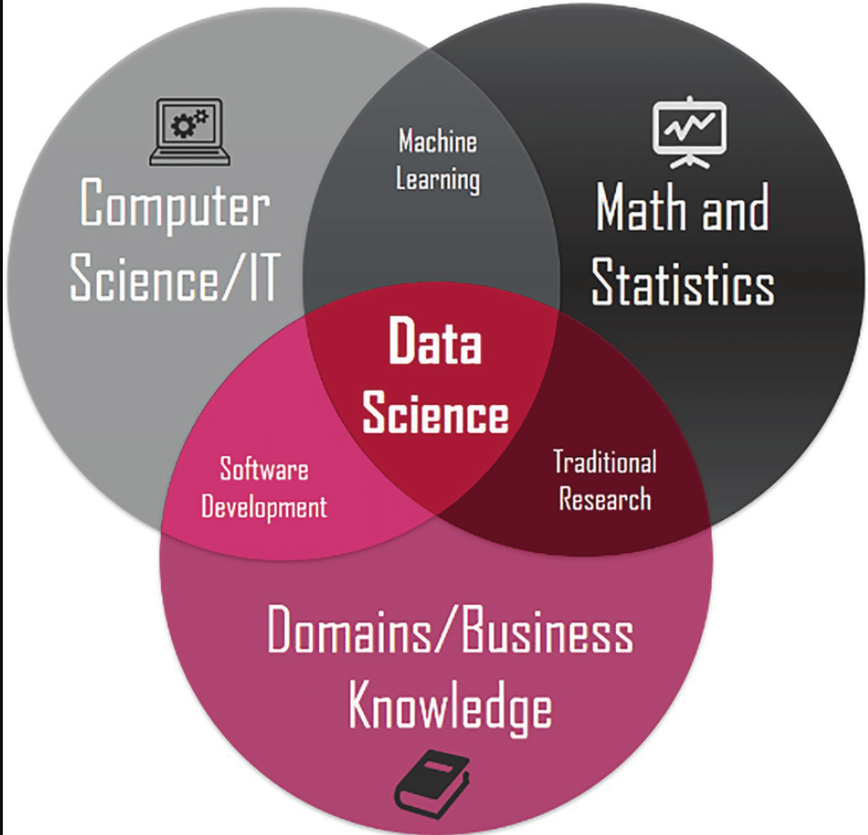

Slide 3
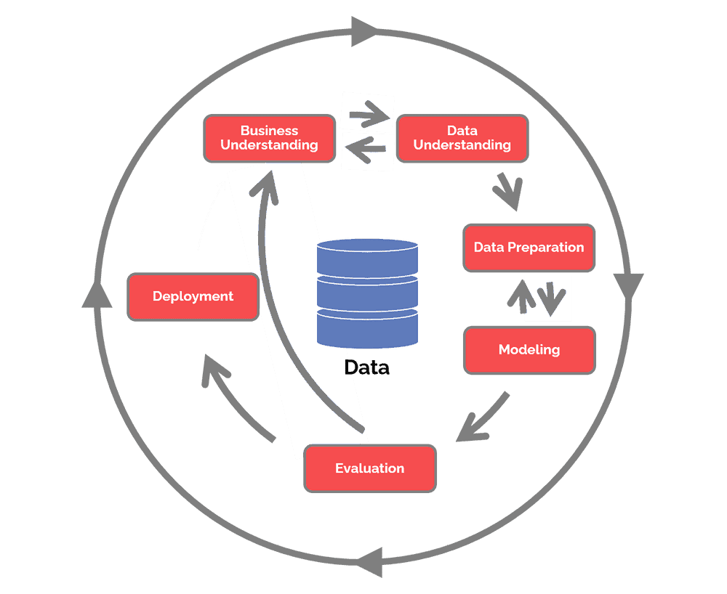
CRISP-DM

Slide 4
Machine Learning Intro
field of software algorithms that are capable of learning on their own
without explicit human / developer programming or intervention.
These algorithms can learn to optimize performance in a specific task
(for e.g. making accurate predictions about future outcomes)
based on sample data (training data) or past experience.

Slide 5
Machine Learning Intro
Primary two focus areas
analyzing existing relationships between different features of a dataset
uses the nature of this relationship to make predictions on new data of a similar type
detecting hidden patterns or grouping in datasets that are yet unknown

Slide 6
Machine Learning Intro
Machine learning is a subfield of artificial intelligence
involves development of algorithms based on statistical models that enable computers to improve their performance in specific tasks based on past data related to those tasks.
closely related to data mining and Data Science.

Slide 7
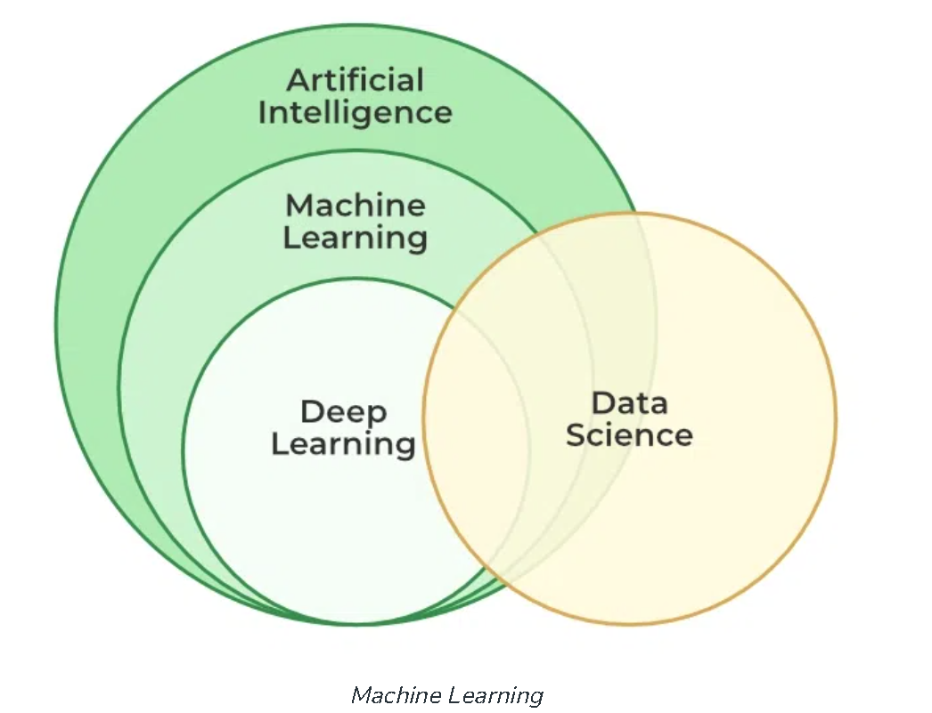

Slide 8
How machine learning works
Forward Pass
ML algorithm takes input data and computes the predictions based on them
Loss Function / Error / Cost function
used to evaluate the accuracy of the predictions made by the model
compares the predicted output of the model to the actual output (labelled data) and calculates the difference between them (error / loss)
The goal of the model is to minimize the error or loss function by adjusting its internal parameters / weights

Slide 9
How machine learning works
Model Optimization Process
iterative process of adjusting the internal parameters of the model to minimize the error or loss function.
Typically achieved via an optimization algorithm, such as gradient descent until the error is minimized to a satisfactory level.

Slide 10
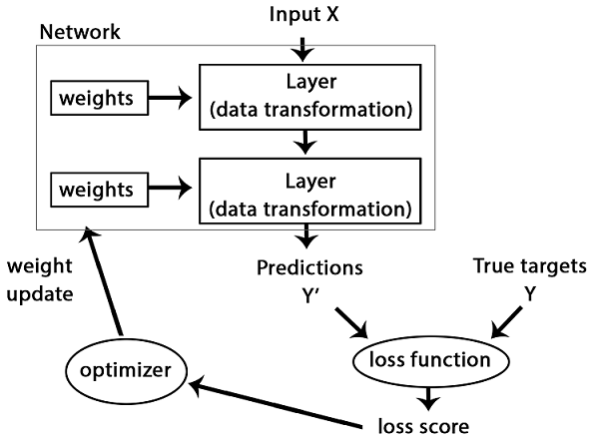
How machine learning works

Slide 11
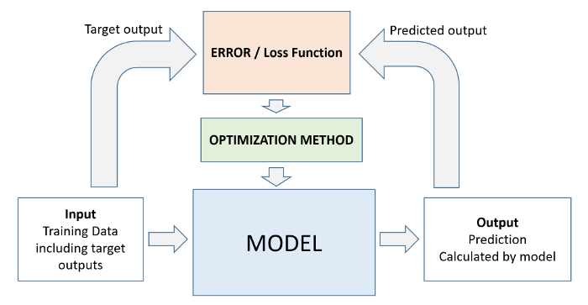
How machine learning works

Slide 12
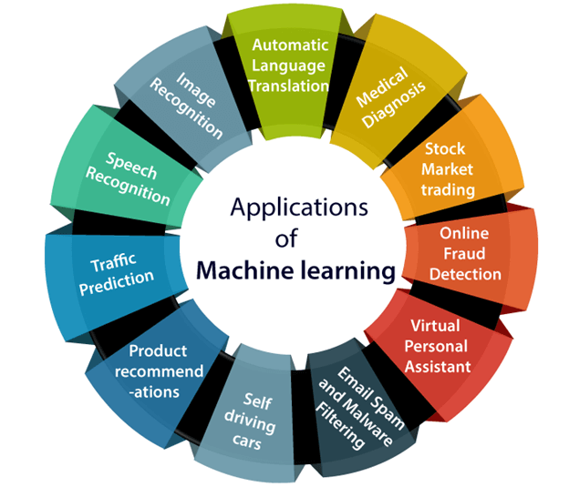

Slide 13
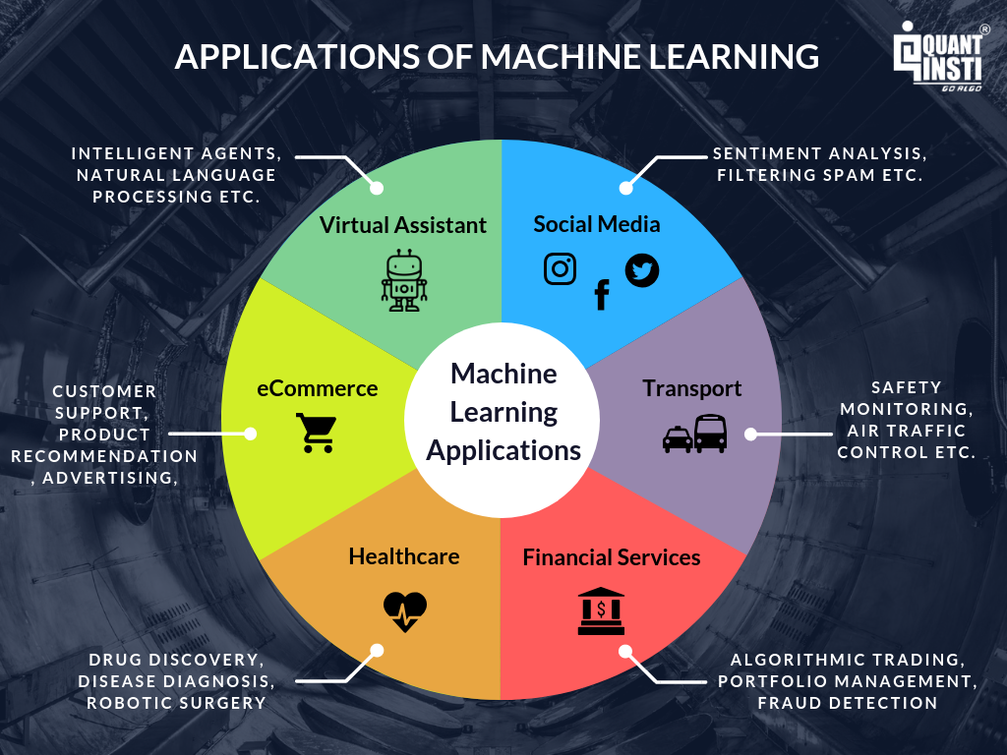

Slide 14
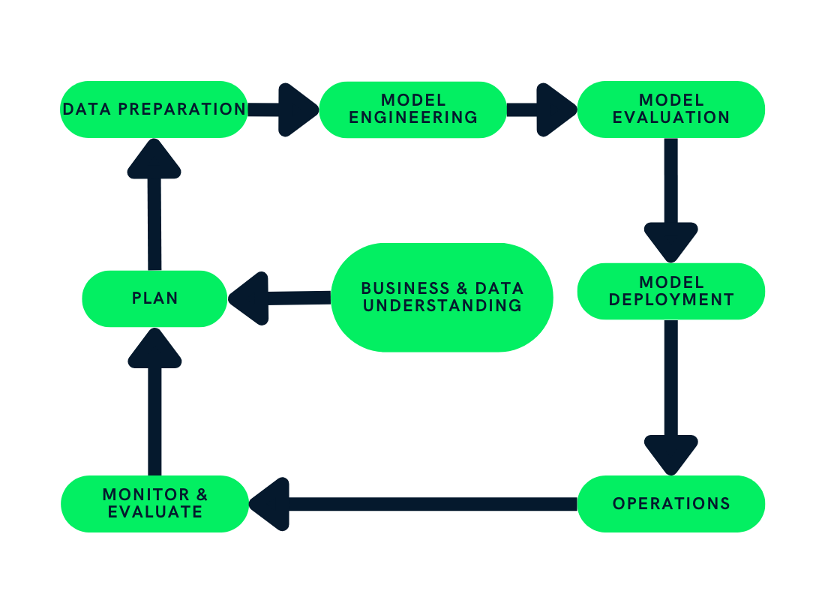
Machine Learning Lifecycle

Slide 15
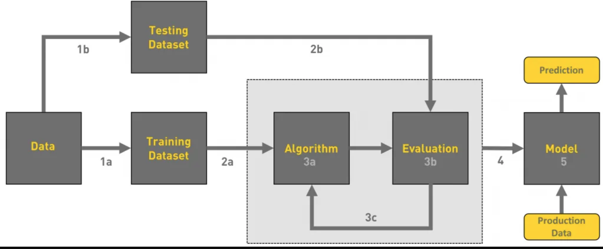
Machine Learning Workflow

Slide 16
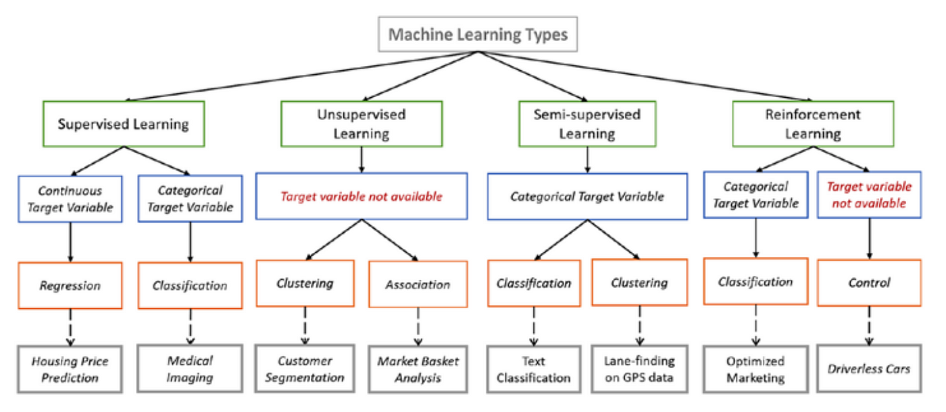

Slide 17
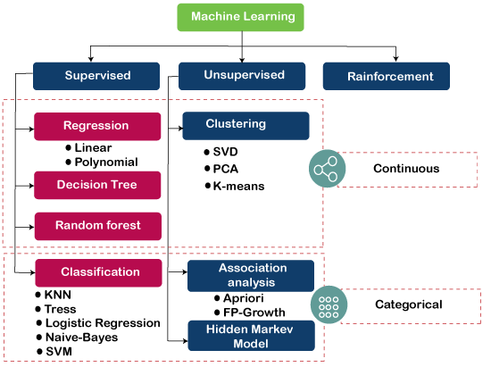

Slide 18
Supervised Learning
ML model is trained on a labelled data set
This contains independent / feature variables and a dependent / target variable (the labels)
The feature variables are the attributes or properties of the data set that influence the dependent / target variables

Slide 19
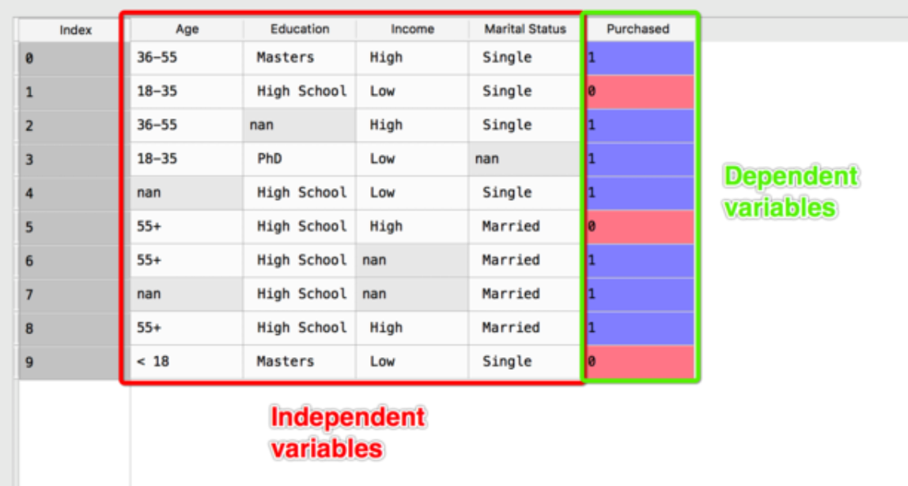
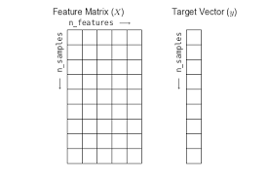

Slide 20
Supervised Learning
The target variable provides context for training the ML model
in order to identify a specific relationship between the features and target variable
The training process is termed fitting the model
The trained model can then make a reasonably accurate prediction of target values corresponding to new features that it has yet to encounter.

Slide 21
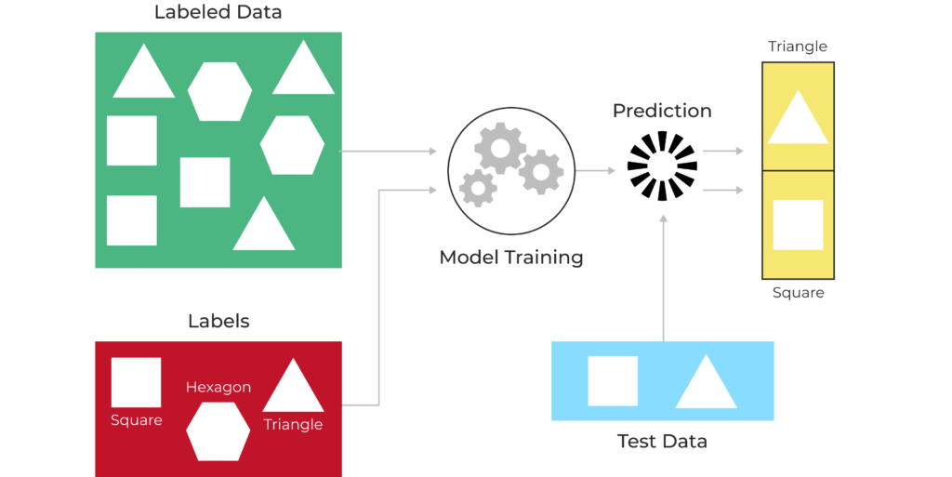
Supervised learning

Slide 22
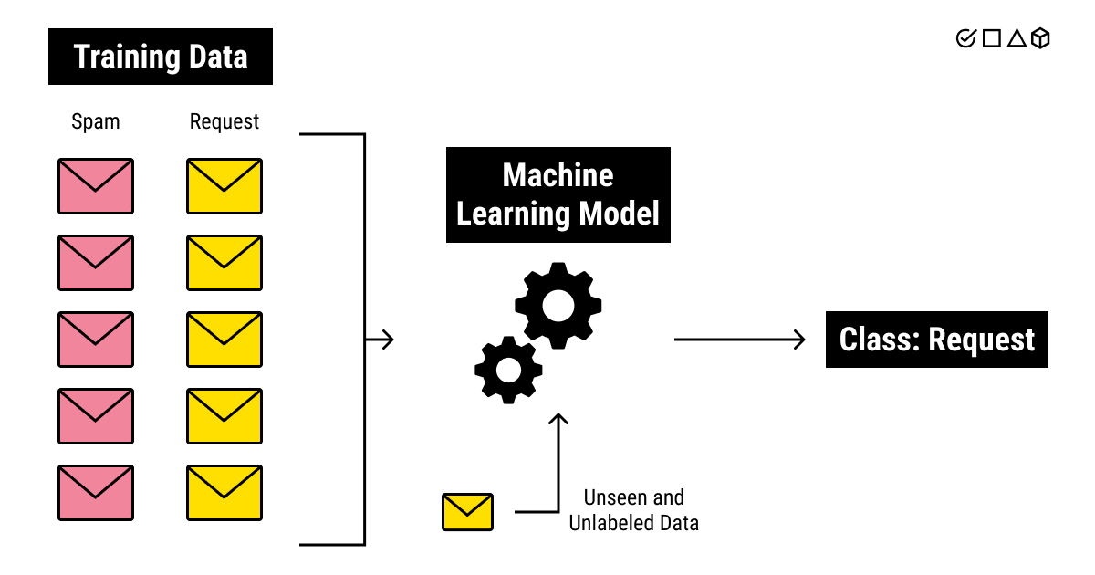
Supervised learning

Slide 23
Supervised learning
During the training process
ML model iteratively predicts the target variable from the features of each observation / datapoint in the original dataset
gradually improves its response
By minimizing its error function by processing increasing amounts of labelled data points in the dataset

Slide 24
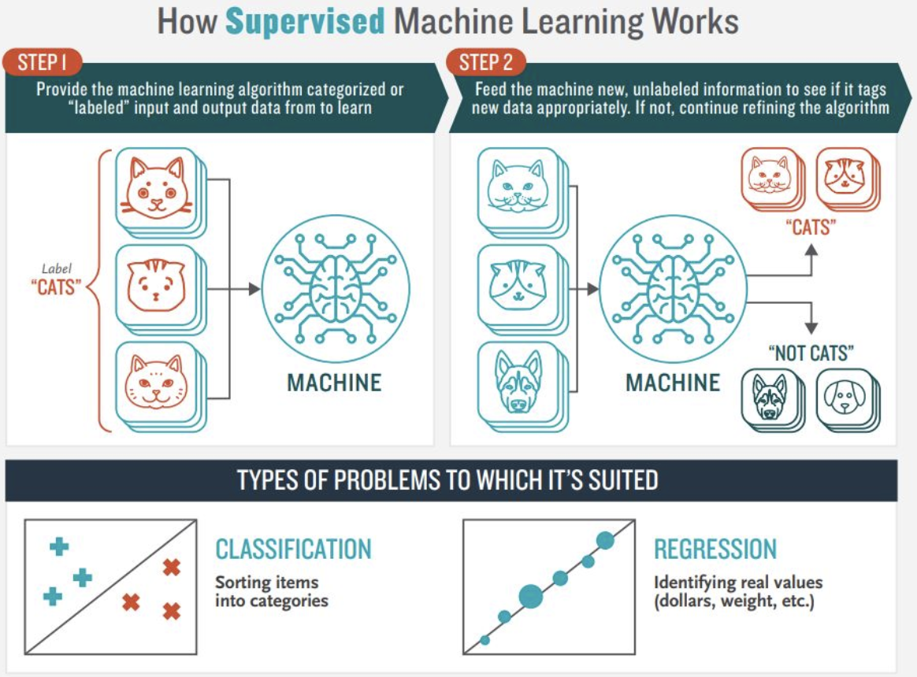

Slide 25
2 main types
Regression
used to predict a continuous target variable, such as price of a house or salary of an employee
Classification
used to predict a categorical target variable (or class label) which has discrete values
e.g. whether a customer will buy a house or not, default on a loan or not, etc.
Binary classification - For simple cases where the values are true or false
Multiclass classification - when there are more than two classes or types of values

Slide 26
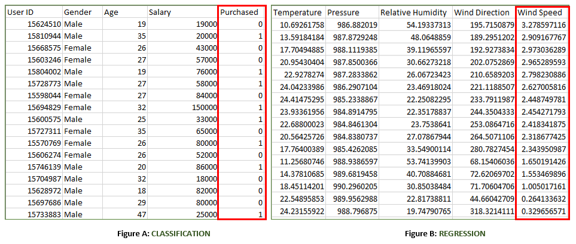
Classification vs regression

Slide 27
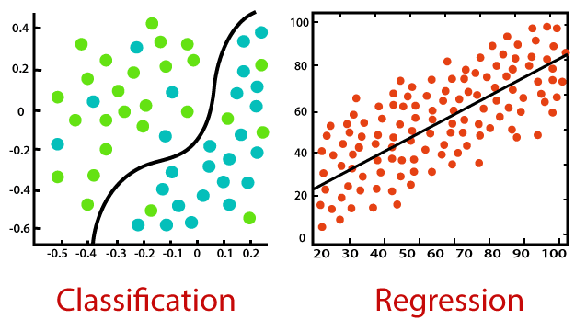
Classification vs regression

Slide 28
Unsupervised Learning
ML model works on its own
discover previously undetected patterns or groupings within a dataset on its own
Input dataset to this model consists only of feature variables without any target variables (i.e. an unlabeled dataset)
typically applied to build a meaningful summary / representation of the unlabeled dataset
so humans can derive useful insights from it

Slide 29
Clustering
grouping observations in the dataset based on their similarities / differences
When two instances appear in same / different groups, we can infer they have similar / dissimilar properties
There many different types of clustering
Exclusive, Overlapping, Hierarchical and Probabilistic

Slide 30
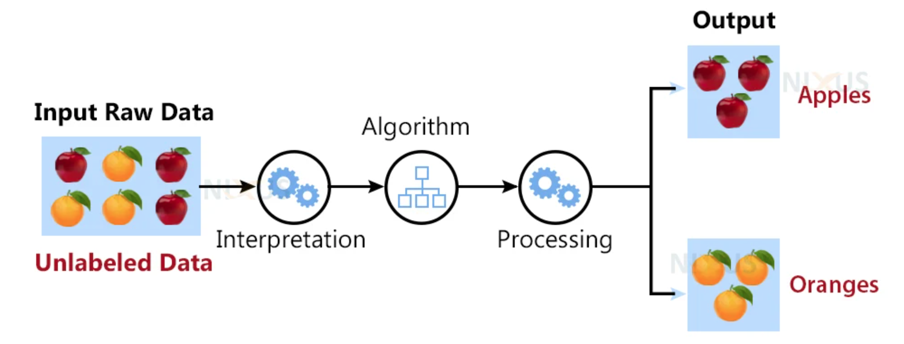
Unsupervised learning

Slide 31

Unsupervised learning

Slide 32
Association rules
takes a rule-based approach to discovering interesting relationships between features in a given dataset
works by using a measure of interest to identify strong rules found within a dataset
typically used for market basket analysis

Slide 33
Dimensionality Reduction
used when the number of features, or dimensions, in a given dataset is too high
seek to transform data from high-dimensional spaces (many features) to low-dimensional spaces (low number of features)
while at the same time maintaining the integrity or meaningful properties in the original data
These techniques are typically deployed during exploratory data analysis (EDA) or data preprocessing to prepare the data for modeling

Slide 34
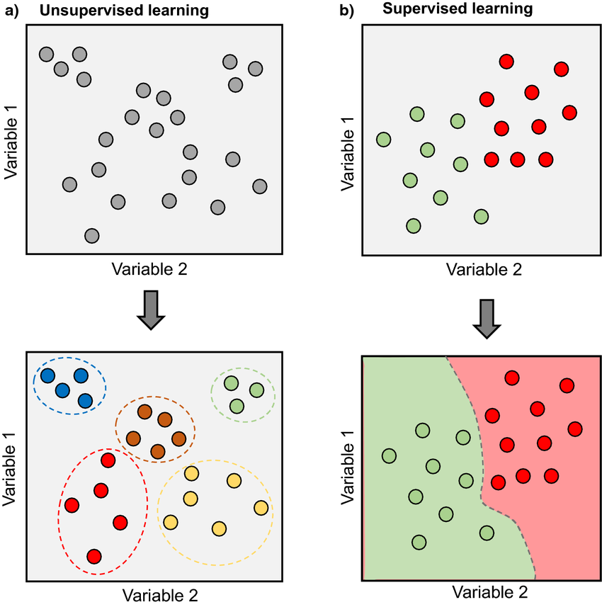
Supervised vs unsupervised

Slide 35
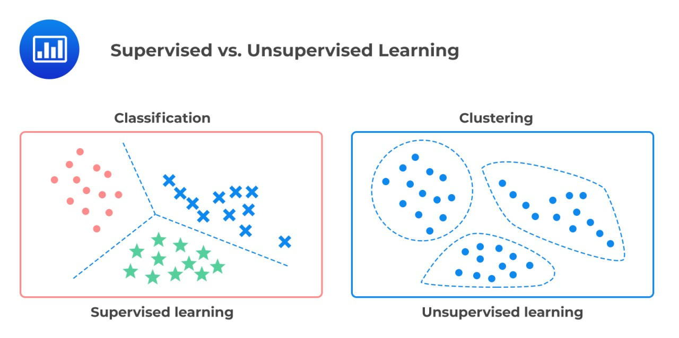
Supervised vs unsupervised

Slide 36
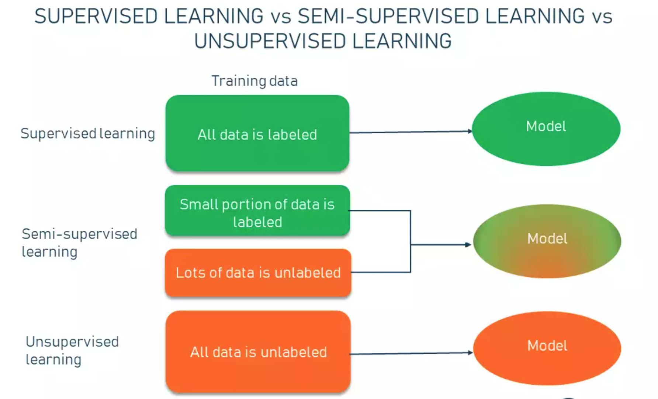

Slide 37
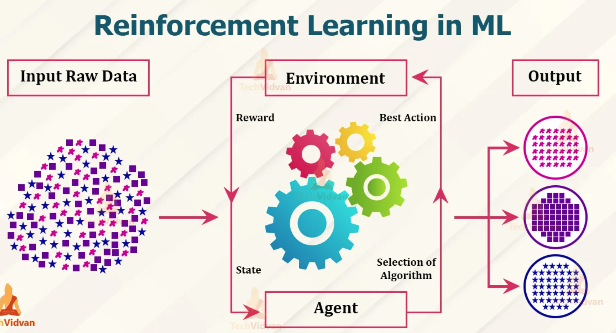

Slide 38
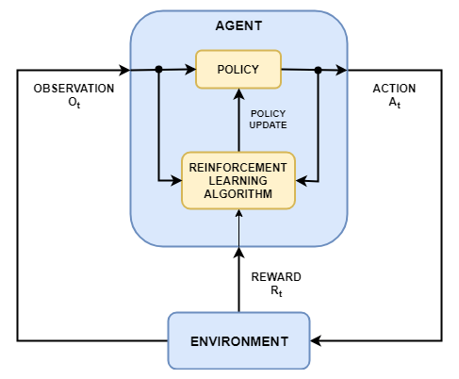
Reinforcement learning

Slide 39
Supervised learning: Regression
Linear Regression
Simple Linear Regression
Multiple Linear Regression
Polynomial Regression
Support Vector Regression (SVR)
Decision Tree Regression
Random Forest Regression

Slide 40
Supervised learning: Classification
Logistic Regression
K-Nearest Neighbors
Support Vector Machine (SVM)
Kernel SVM
Naïve Bayes
Decision Tree Classification
Random Forest Classification

Slide 41
Unsupervised Learning
K-Means Clustering
Hierarchical Clustering
Principal Component Analysis (PCA)
Linear Discriminant Analysis (LDA)
Kernel PCA

Slide 42
Model Selection
Model accuracy scoring
K-Fold Cross Validation
Grid Search
XGBoost

